Slide 1
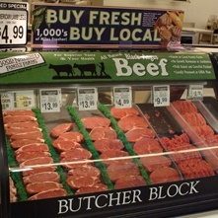
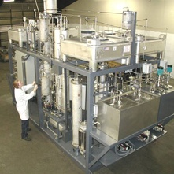
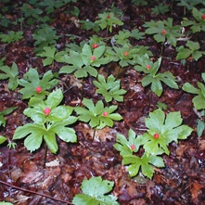
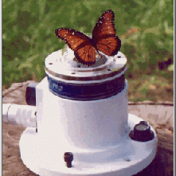

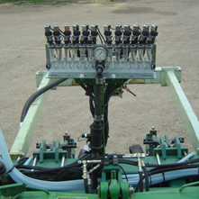
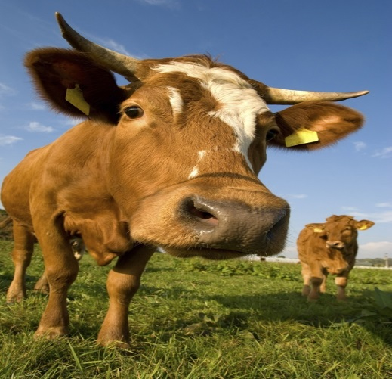
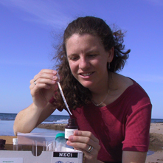
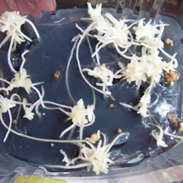
To Advance Knowledge
For Agriculture, the Environment, Human Health and Well-being, and Communities
National Institute
of Food
And Agriculture

Slide 2
Features of USDA SBIR Program
Award Grants Only - Ideas are Investigator-Initiated
Awards Based on Scientific and Technical Merit, PI and Company Qualifications, and Commercial Potential
Proposals Reviewed by Confidential Peer Review Using Outside Experts From Non-profit Organizations
Funds Allocated to Topic Areas in Proportion to Number of Proposals Received
Subcontracting to Universities and USDA Labs Permitted and Encouraged

Slide 3
Features of USDA SBIR Program
Phase I Grants = 8 Months/$100,000
Phase II Grants = 2 Years/$600,000
12 Month No-cost Extension Available
Commercialization Assistance Programs for Both Phase I and Phase II Winners
Contact with SBIR Program Available Anytime

Slide 4
Topic Areas
Plant Production & Protection – Biology
Plant Production & Protection - Engineering
Animal Production & Protection
Aquaculture
Food Science & Nutrition
Biofuels and Biobased Products
Air, Water and Soils
Forests and Related Resources
Rural and Community Development
Small & Mid-Size Farms

Slide 5
Technology Areas Supported by the USDA/SBIR Program
Information Technology
Robotics
Electronics
Biotechnology
Nanotechnology
Microelectro Mechanical Systems (MEMS)
Acoustics
Remote Sensing
Genetic Engineering
Material/Coatings
Food Safety
Biofuels
Machine Vision
Precision Agriculture
Engineering
Physics
Chemistry

Slide 6
Application Submission
Application Submission Requires Many Steps to Complete the Process
Download the USDA SBIR Solicitation at http://www.nifa.usda.gov/funding/sbir/sbir.html
Electronic Submission is Mandatory via Grants.gov
Obtain Data Universal Number System (DUNS) Number
Register with System for Award Management (SAM) (replaced Central Contractor Registry (CCR)
Register your Business with Grants.gov
http://www.grants.gov/applicants/get_registered.jsp
Register your company with the Small Business Administration (SBA)
https://www.sbir.gov/registration

Slide 7
Solicitation/Proposal Schedule:
Phase I
FY 2018 Solicitation will be Released Late June/Early 2017
Phase I Proposal Deadline will be October 5, 2017
Panels will Meet in January & February of 2018
Award Decisions will be Made in Early March 2018
Phase I Grant Period will be from June 1, 2018 to January 31, 2019
Phase II
FY 2017 Solicitation was released in late December of 2016 (only prior USDA Phase I winners are eligible)
Phase II Proposal Deadline Date is be March 2, 2017
Phase II Grant Period will be from September 1, 2017 to August 31, 2019

Slide 8
History of USDA SBIR Funding

Slide 9
Geographical Distribution Of USDA SBIR Winners FY83- FY16

Slide 10
University and Government Scientist Involvement in USDA SBIR Program
Strongly encouraged
Scientists may serve as consultants or receive a subcontract (limited to no more than 1/3 of Phase I award or 1/2 of Phase II award) and continue to work full time at their home institution
Scientists may serve as the principal investigator on an SBIR grant, by reducing employment at their home institution to 49% for the duration of the grant and if the SBIR research is performed someplace other than their research lab
It is usually not acceptable for university or government scientists to serve as consultants and have all the research done in their lab

Slide 11
Advice for Phase I
Provide a VISION of where you want to be at the end of Phase II
Focus the Phase I research on critical enabling factor(s)
Sell the importance of your project
Provide a detailed experimental plan
Provide insight into commercial potential
Show connectivity with the communities you are intending to serve

Slide 12
Factors that Improve Chances for Commercial Success
High Scientific/Technical Merit
Good Consultants, CRADA
Business Expertise
Phase III Partners
Marketing Plan
Participate in the Phase I and Phase II Commercialization Assistance Programs

Slide 13
USDA SBIR HOMEPAGE www.nifa.usda.gov/fo/sbir
Program Information
Solicitation (Request for Applications)
Technical Abstracts
Link to SBA and Other SBIR Programs
Upcoming SBIR Conferences
Find the Expert (CRIS & ARS)
PowerPoint Presentation
Success Stories
Impact Newsletter

Slide 14
U.S. Department of Agriculture Small Business Innovation Research Program
Dr. Charles Cleland
Biofuels and Biobased Products
Dr. Jodi Williams
Food Science and Nutrition
Dr. Robert Nowierski
Plant Production and Protection –
Biology
Dr. Denis Ebodaghe
Small and Mid-Size Farms
Scott Dockum
Program Coordinator, SBIR
Elden Hawkes
Program Specialist, SBIR
Dr. Charles Cleland
Forests and Related Resources
Dr. Gene Kim
Aquaculture
Dr. Brent Elrod
Rural and Community Development
Dr. Robert Smith
Animal Production and Protection
Dr. Karelyn Cruz
Air, Water and Soils
Dr. Rachel Melnick
Plant Production and Protection - Engineering

Slide 15
SUCCESS
STORIES

Slide 16
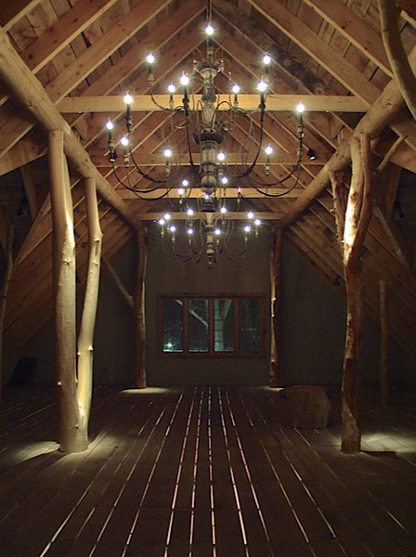
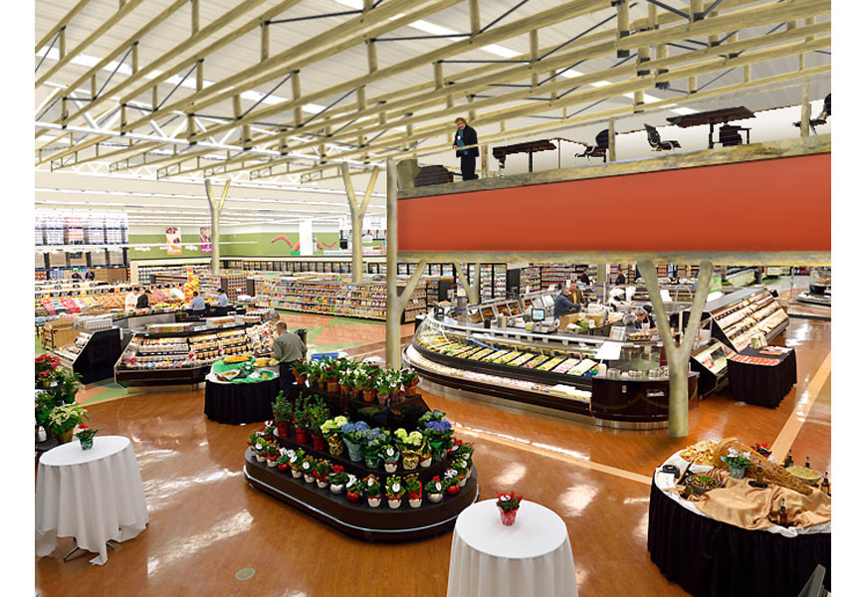
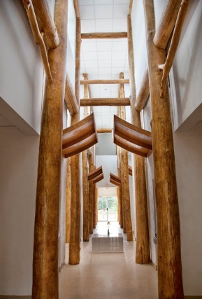
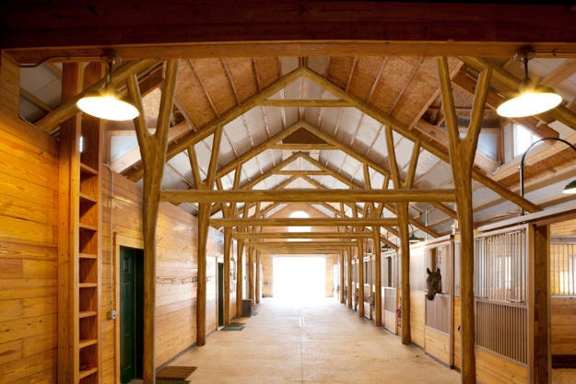
Whole Trees, LLC
Technology Developed
Structural Testing of Branched Timber and Truss Assemblies
Round timber can substitute for steel and concrete in medium and large scale construction under Type IV: "Heavy Timber Framing."
SBIR History
Phase I – 2011 ($99K)
Phase II – 2012 ($362K)
8.1 Forests and Related Resources
Commercialization Success
The company will provide the ceiling joists of the 57,000-square-foot Festival Foods grocery store which will include ash trees being removed from the city of Madison due to emerald ash borer infestation.
Raised $1.6M in private equity funding since the initial SBIR grant.

Slide 17
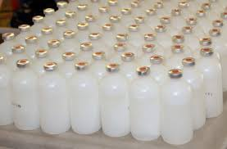
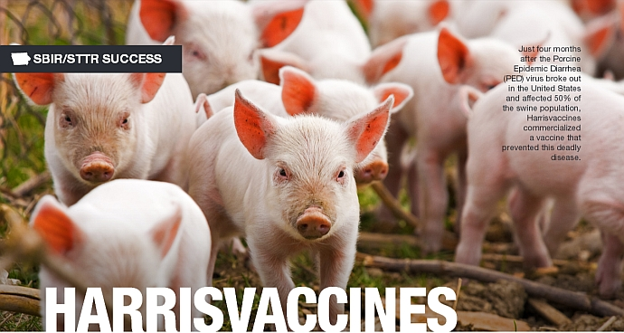
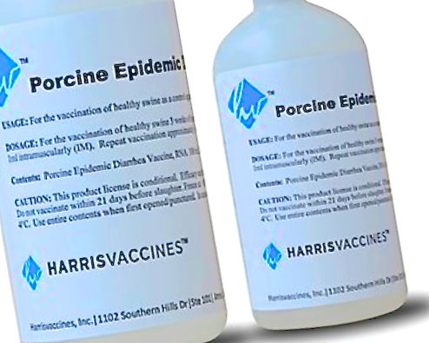
Harrisvaccines, Inc.
Technology Developed
Developed new custom, life-saving vaccines that responds to new diseases as they emerge for livestock.
Developed a rapid 4-6 week production time for each new vaccine.
SBIR History
Phase I in 2009 ($100K);
Phase II in 2009($346K);
8.3 Animal Production and Protection
Commercialization Success
Just four months after the Porcine Epidemic Diarrhea (PED) virus broke out in the United States and affected 50% of the swine population, Harrisvaccines commercialized a vaccine that prevented this deadly disease.
Went from selling 1 million doses of vaccines in 2012 to selling 5-7 million doses a year currently
November 12, 2015, Merck Animal Health Acquired Harrisvaccines for a undisclosed amount.

Slide 18
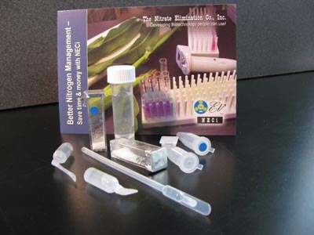
Nitrate Elimination Company, Inc.
Technology Developed
Developed nitrate test kits that allow farm managers to determine nitrate accumulation levels on the farm.
This test kit will help agricultural producers manage nitrate concentrations, reduce costly nitrogen fertilizer applications, and protect the environment from pollution.
SBIR History
Phase I – 2006 ($80K)
Phase II – 2007 ($364K)
8.4 Air, Water and Soils
Commercialization Success
In the final stages to receive EPA certification as a standard method for all nitrate testing under the Clean Water Act.
Nitrate test kits are used as the standard method within all US Geological Survey (USGS) soil laboratories.

Slide 19
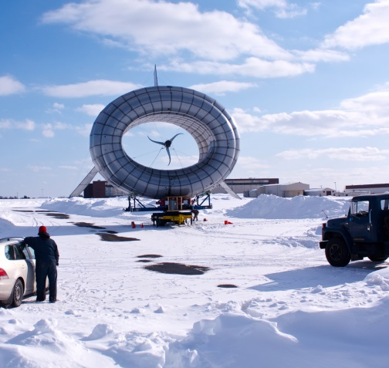
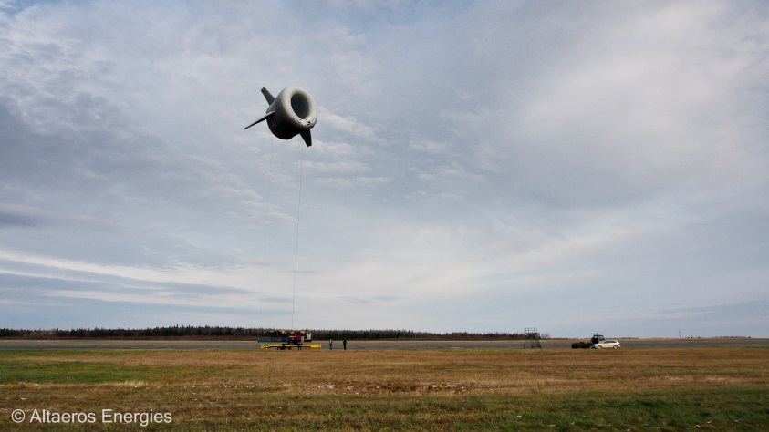
Altaeros Energies
Technology Developed
Altaeros Buoyant Airborne Turbine (BAT) leverages proven aerospace technology to lift a wind turbine into the strong, consistent winds beyond the reach of traditional towers.
SBIR History
Phase I – 2011 ($100K)
Phase II – 2012 ($450K)
8.6 Rural Development
Commercialization Success
First commercial products to be sold in 2015.
Technology was featured in CNN’s 2014 edition of THE CNN 10: Inventions and in the New York Times.
Telecoms group SoftBank has invested $7m in Altaeros Energies for future deployment of the BAT technology in Japan.

Slide 20

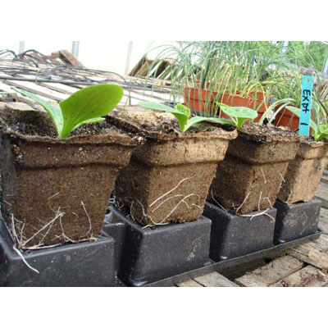
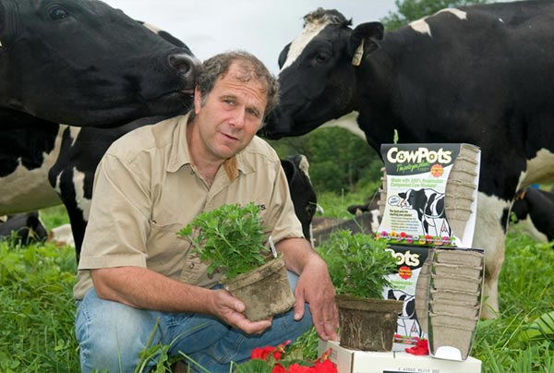
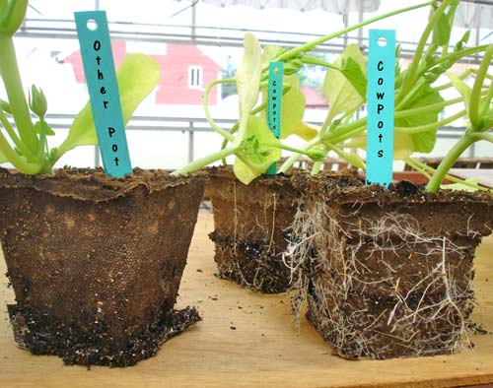
Freund`s Farm, Inc.
Technology Developed
What began on the farmhouse kitchen stove as an idea for a better biodegradable pot has grown into year round production of millions of CowPots to date. From a 3 inch pot for seed starting to a 17 inch pot for trees and shrubs, CowPots, LLC has expanded their innovative product line to match the diverse needs of the green industry.
SBIR History
Phase I in 2006 ($54K);
Phase II in 2007($317K);
8.11 Animal Waste Management (Topic Area Discontinued)
Commercialization Success
Since being featured on Discovery Channel’s “Dirty Jobs” with Mike Rowe in 2007, CowPots are now available internationally.
Can be purchased from major worldwide sellers such as Amazon.com, cowpots.com and greenhousemegastore.com.

Slide 21
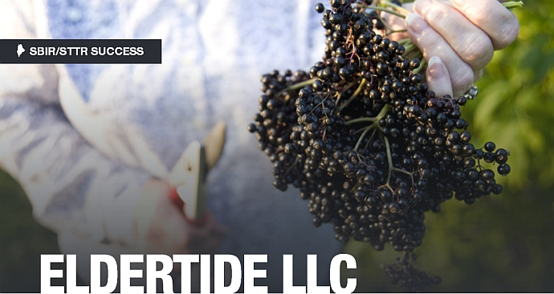
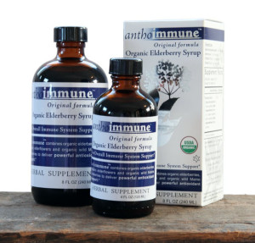
Eldertide, LLC.
Technology Developed
Began by looking at native species of elderberries to see which had the highest antioxidant profiles and could be successfully cultivated.
Led to the development of a proprietary juice blend with benefits that include strong anti-viral properties, particularly against certain strains of the flu.
SBIR History
Phase I in 2009 ($80K);
Phase II in 2010($400K);
8.12 Small and Mid-Size Farms
Commercialization Success
Product line, developed with the help of three SBIR awards, is available for purchase at Whole Foods stores nationwide.
Nearly $700,000 with an additional $575,000 pending.
Average annual growth of over 50%.

Slide 22
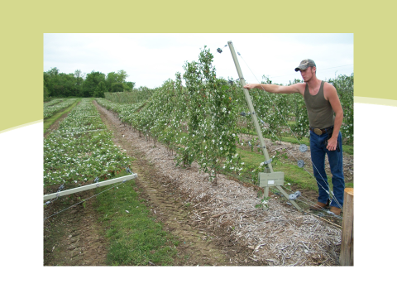
Trellis Growing Systems
Technology Developed
Developed trellis system for cultivation of blackberries in IN, OH and adjacent states
Trellis system 1) protects plants against cold and desiccation in the winter, 2) protects fruit against sun scorch, and 3) reduces harvesting labor by 33%
SBIR History
Phase I – 2008 ($74K)
Phase II – 2009 ($350K)
8.13 Plant Production & Protection - Engineering
Commercialization Success
Establishment of blackberry industry where it did not exist before
Trellis system has been installed on more than 60 farms with over 300 acres in cultivation that generate sales of over $9 million/year

Slide 23
U.S. Department of Agriculture Small Business Innovation Research Program
Elden Hawkes
Waterfront Centre
800 9th Street, SW, Suite 3258
Washington, DC 20024
Phone: (202) 401-6516 Fax: (202) 401-6070
E-mail: ehawkes@nifa.usda.gov
Web Site: www.nifa.usda.gov/fo/sbir

Slide 24
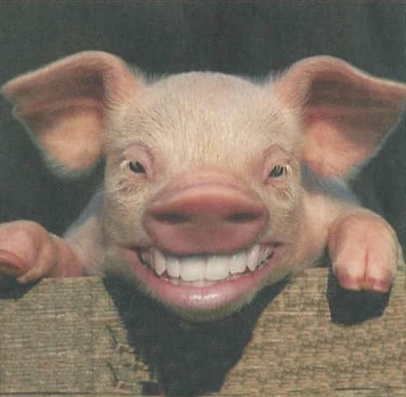
ANY QUESTIONS?

