Slide 1
Goals
What are your challenges with time management?
What do you do that works well?
What is one goal/learning objective you have for today?

Slide 2
How the average college student spends their weekdays:
Notes:
Many of you have shared what your goals for this workshop. This beautiful pie chart was taken from the Bureau of Labor Statistics and it shows how the average college student spends their weekdays. My freshman year my weekdays consisted of sleeping a lot, around twelve hours, going to class, eating, and occasionally studying. This got me in a bit of trouble when it was come test time. I would cram the day before the test and the majority of the time I found myself stressed out and overwhelmed with the amount of material I had to learn.
Everyone was given two calendars. If you would all take a moment and fill out how your schedule looks two weeks prior to a test.

Slide 3
Example Student Schedule

Slide 4
Notes:
Now, to me this schedule looks beautiful. There’s all this free time to watch Sons of Anarchy, sleep, and hang out with your friends. However, this isn’t how your schedule should look like 2 weeks prior to a test.
One thing you may notice is that there is quite a bit of free time on this schedule. Now you’re in college, you have the ability to chose when you study and when you don’t.
Typical student takes 12-15 credits per semester, which means 12–15 hours IN THE CLASSROOM.

Slide 5
What your days might REALLY look like….
Notes:
This is funny, please read it.

Slide 6
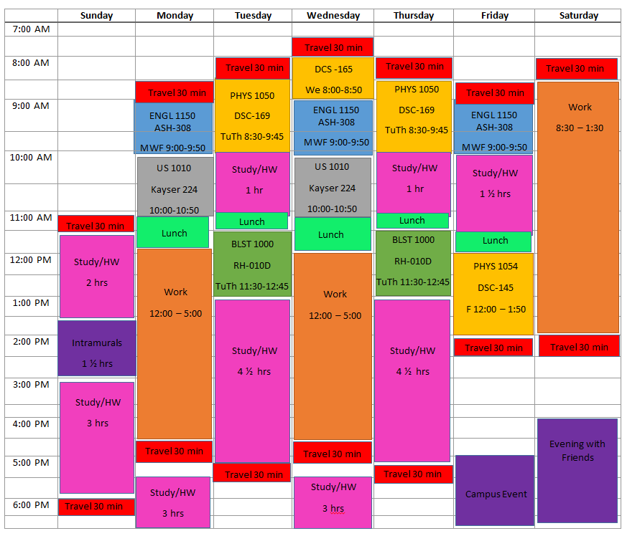
Notes:
Everyone schedules their time differently, some use planners, their phones, calendars, while others are more conceptual (plan mentally).
You will have free time available, but you will need to structure it!
Free time is important for socializing, making friends, getting involved in campus activities and organizations.

Slide 7
How to Create a Balance

Slide 8
Managing Your Time
Factors to consider:
Homework (form of studying)
Meals
Activities/Leisure/Entertainment
Family responsibilities
Employment
Volunteerism
Notes:
These are some factors you need to consider in organizing or structuring your time.
This afternoon, you will have the opportunity to create your on class schedule.

