Slide 1
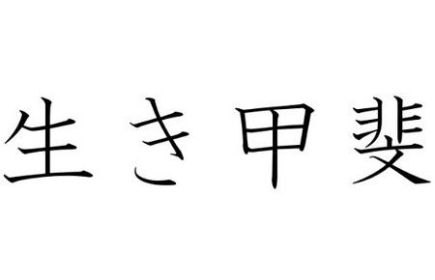
Iki = Life Kai = Value/Worth
Ikigai = A Reason for being
= Having Direction or Purpose in life

Slide 2
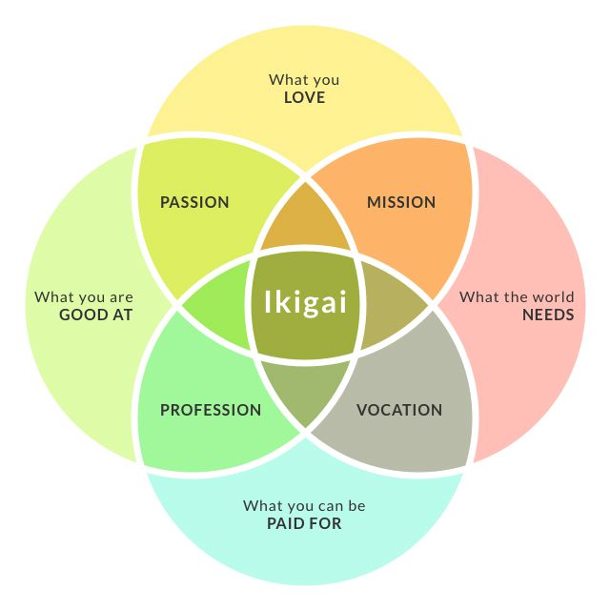

Slide 3
What do you love?
What aspects of your life bring you into your heart and make you come alive?
What did you love doing or thinking about when you were a child?
What activities do you do in your spare time that make you happy?

Slide 4
What are you good at?
What are your skills and strengths?
What do people ask your help for?
What talents have you cultivated
What do you excel at?

Slide 5
What cause do you believe in?
What/Who inspire you?
What makes you angry, frustrated?
What change would you most love to create in the world?
What would you give your life for?

Slide 6
What can you be paid for?
What service, value or offering do you bring, or could you bring, that brings real value to others?
What job could you do?

