Slide 1
Automatic Program Rewriting in Non-Ground Answer Set Programs
Nick Hippen & Yuliya Lierler
University of Nebraska at Omaha

Slide 2
Outline
Background
Projection
$α$
$β$
Experimental Results

Slide 3
BACKGROUND

Slide 4
What is Answer Set Programming (ASP)?
Constraint programming paradigm geared towards solving difficult combinatorial search problems
Prolog-like syntax
Logic Rule
$$child\left(X,Y\right)←parent\left(Y,X\right).$$
$$innocent\left(X\right)←not guilty\left(X\right).$$
Meaning
X is a child of Y if Y is a parent of X.
X is innocent if I have no reason to believe that X is guilty
Head $←$ Body

Slide 5
ASP Solver Architecture & Grounding
logic
program
Grounder
grounded
program
ASP Solver
answer
sets
Logic Program | Grounded Program | Intelligently Grounded Program
$$parent\left(bob,ally\right). \\ parent\left(mary,john\right). \\ sibling\left(bob,mary\right).$$ $$cousin\left(X,Y\right)←parent\left(P1,X\right), \\ parent\left(P2,Y\right), \\ sibling\left(P1,P2\right), \\ X≠Y.$$ | $$parent\left(bob,ally\right). \\ parent\left(mary,john\right). \\ sibling\left(bob,mary\right).$$ $$cousin\left(john,mary\right)←parent\left(ally,john\right), \\ parent\left(bob,mary\right), \\ sibling\left(ally,bob\right), \\ john≠mary. \\ … \\ cousin\left(bob,bob\right)←parent\left(bob,bob\right), \\ parent\left(bob,bob\right), \\ sibling\left(bob,bob\right), \\ bob≠bob. \\ …$$ | $$parent\left(bob,ally\right). \\ parent\left(mary,john\right). \\ sibling\left(bob,mary\right).$$ $$cousin\left(ally,john\right)←parent\left(bob,ally\right), \\ parent\left(mary,john\right), \\ sibling\left(bob,mary\right), \\ ally≠john.$$
Notes:
Answer sets produced by ground program coincide with intelligently grounded program

Slide 6
Motivations
Intuitive encodings are not always the most optimal
Fine-tuning requires expertise
Smaller grounding sizes often translate into faster solve times
Eliminating variables from rules can lead to smaller grounding size
Question
What fine-tuning can be done automatically via program rewriting techniques?
Notes:
Start with “When one is working on… not always most optimal… etc. etc.”

Slide 7
ASP Solver Architecture Extended
logic
program
PROJECTOR
rewritten logic
program
Grounder
grounded
program
ASP Solver
answer
sets

Slide 8
Our Direction
Inspired by relational databases
Two considered rewritings
$α$-projection
$β$-projection

Slide 9
$α$-PROJECTION

Slide 10
Intuition for $α$-projection
From Permutation Pattern Matching (ASPComp14):
kval(K) :- p(K,P), patternlength(L), K <= L.
Identify candidates for projection (variables that are only in the body)
Candidates = {P, L}
Select candidate(s)
For instance, P
Identify literals containing selected variable(s)
{p(K,P)}
$α$-literals

Slide 11
Projector Result (PPM): $α$
Identify candidates for projection (variables that are only in the body)
Candidates = {P, L}
Select candidate(s)
For instance, P
Identify literals containing selected variable(s)
{p(K,P)}
$α$-literals
Logic Program | PROJECTOR: $α$-projection (Project P)
kval(K) :- p(K,P), patternlength(L), K <= L. | p_0(K) :- p(K,P). kval(K) :- p_0(K), patternlength(L), K <= L.
Project P

Slide 12
Projector Result (Labyrinth): $α$
Logic Program
reach(X,Y,T) :- reach(XX,YY,T), dneighbor(D,XX,YY,X,Y), conn(XX,YY,D,T), conn(X,Y,E,T), inverse(D,E), step(T).

Slide 13
Projector Result (Labyrinth): $α$
Logic Program | PROJECTOR: $α$-projection (Project E)
reach(X,Y,T) :- reach(XX,YY,T), dneighbor(D,XX,YY,X,Y), conn(XX,YY,D,T), conn(X,Y,E,T), inverse(D,E), step(T). | p_0(Y,D,T,X) :- inverse(D,E), conn(X,Y,E,T). reach(X,Y,T) :- reach(XX,YY,T), dneighbor(D,XX,YY,X,Y), conn(XX,YY,D,T), step(T), p_0(Y,D,T,X).
Project E

Slide 14
$β$-PROJECTION

Slide 15
$β$-Projection
Expansion of $α$-projection
Carry “guards” for variables when possible
Attempts to restrict the domain of variables in a rule as much as possible without introducing new variables

Slide 16
Intuition for $β$-projection
From Labyrinth (ASPComp14):
reach(X,Y,T) :- reach(XX,YY,T), dneighbor(D,XX,YY,X,Y), conn(XX,YY,D,T), conn(X,Y,E,T), inverse(D,E), step(T).
Identify candidates for projection (variables that are only in the body)
Candidates = {XX,YY,D,E}
Select a candidate, here we select E
Identify literals containing our selected variable (we’ll call this set L)
{conn(X,Y,E,T), inverse(D,E)}
$α$-literals
Identify literals where all of its variables are a subset of all variables in L
{conn(X,Y,E,T), inverse(D,E), step(T)}
$β$-literals
Notes:
Practice

Slide 17
Projector Result (Labyrinth): $β$
Logic Program | PROJECTOR: $β$-projection (Project E) | PROJECTOR: $α$-projection (Project E)
reach(X,Y,T) :- reach(XX,YY,T), dneighbor(D,XX,YY,X,Y), conn(XX,YY,D,T), conn(X,Y,E,T), inverse(D,E), step(T). | p_0(Y,D,T,X) :- inverse(D,E), conn(X,Y,E,T), step(T). reach(X,Y,T) :- reach(XX,YY,T), dneighbor(D,XX,YY,X,Y), conn(XX,YY,D,T), step(T), p_0(Y,D,T,X). | p_0(Y,D,T,X) :- inverse(D,E), conn(X,Y,E,T). reach(X,Y,T) :- reach(XX,YY,T), dneighbor(D,XX,YY,X,Y), conn(XX,YY,D,T), step(T), p_0(Y,D,T,X).
Project E
Notes:
Emphasize that the last rule is the same for both alpha and beta

Slide 18
Safety
Rules must be “safe” for ASP technology
Unsafe Rules:
p(A).
:- p(A), not p(A,B).
Safe Rules:
p(1).
:- p(A), not p(A,B), q(B).

Slide 19
Handling Safety Issues
If we don’t handle safety and $α$-project B from the example below…
Logic Program | PROJECTOR: No Safety Handling (Project B)
p(A,D,E) :- q(A,B,C), r(A,D), t(E), not s(B,E). | p_0(A,C,E) :- q(A,B,C), not s(B,E). p(A,D,E) :- r(A,D), t(E), p_0(A,C,E).
Notes:
Fix solution

Slide 20
Handling Safety Issues Cont.
If we don’t handle safety and $α$-project B from the example below…
Logic Program | PROJECTOR: No Safety Handling ($α$-project B) | PROJECTOR: Safety Handling ($α$-project B)
p(A,D,E) :- q(A,B,C), r(A,D), t(E), not s(B,E). | p_0(A,C,E) :- q(A,B,C), not s(B,E). p(A,D,E) :- r(A,D), t(E), p_0(A,C,E). | p_0(A,C,E) :- q(A,B,C), not s(B,E), t(E). p(A,D,E) :- r(A,D), p_0(A,C,E).
Solution: Add the $α$-literals of all unsafe variable(s) until we end up with a safe rule, removing the literals from the original rule.
Notes:
Fix solution

Slide 21
Variable Selection
Select the candidate variable who produces the fewest $α$-literals
If more variables can be projected without introducing more literals into the new rule, add them to the set of variables being projected
If there is a tie, randomly select a variable

Slide 22
Implementation Details
Clingo 5.3.0, utilizing their Python interface “Pyclingo” (Potsdam)
One feature allows for modification of parsed ASP program’s abstract syntax tree (AST)
Modifies the AST to perform projection
Includes post-processing (obtaining answer sets)
Ignores constructs such as aggregates and optimization statements

Slide 23
Related Work
Ground Programs
Propositional program simplification
Non-Ground Programs
Simplify (Eiter, Fink, Tompits, Traxler, Woltran, 2006)
Lpopt (Bichler, Morak, Woltran, 2016)
Notes:
Talk about differences (particularly variable selection & safety for lpopt)

Slide 24
EXPERIMENTAL RESULTS

Slide 25
Experimental Analysis
ASPCCG: ASP based natural language parser
3 encodings of increasing levels of human optimization
Created by Matthew Buddenhagen, Yuliya Lierler & Peter Schuller
Enc1: No human optimization
Enc7: Moderate human optimization
Enc19: Notable human optimization
ASPComp14
Stable Marriage
Permutation Pattern Matching
Knight Tour with Holes
Notes:
Reason for using aspccg: motivation, extensive code base, optimized by human incrementally
Reason for ASPComp14: Stable Marriage & PMM were lpopt success stories, Knight Tour with Holes was failure story

Slide 26
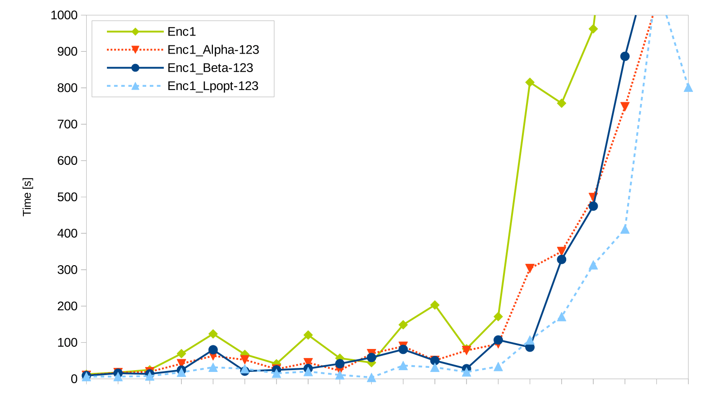
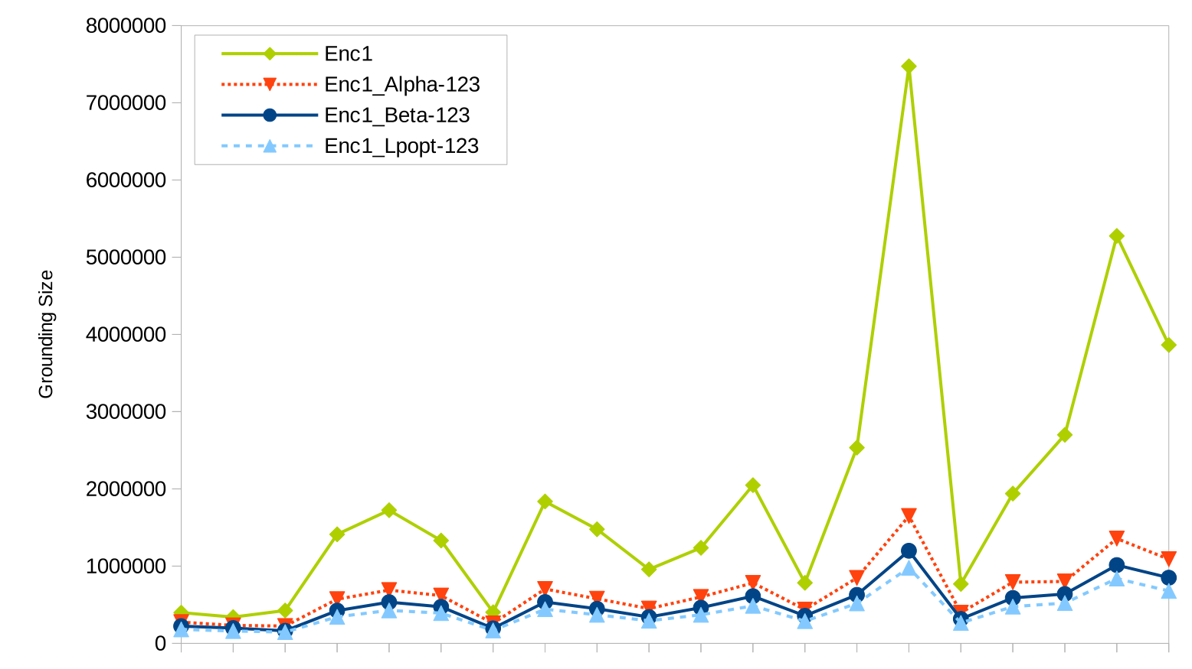
ASPCCG: Encoding 1
Solve Time
Grounding Size

Slide 27
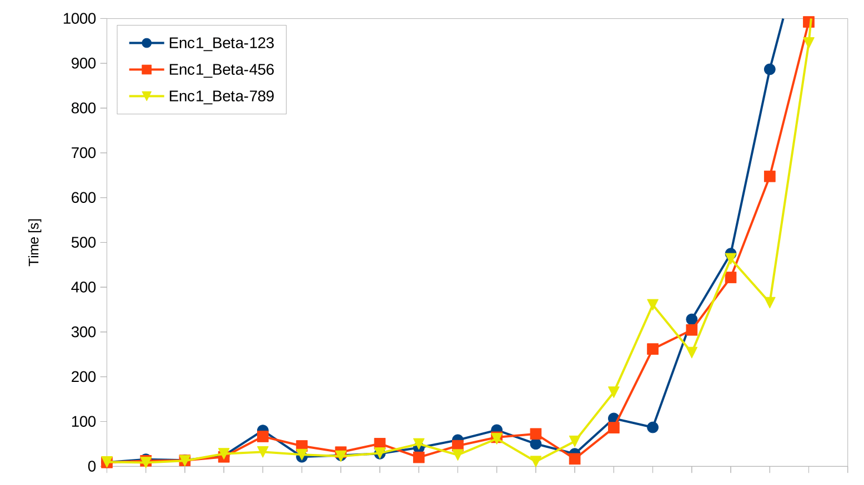
Randomness Comparison
Solve Time

Slide 28
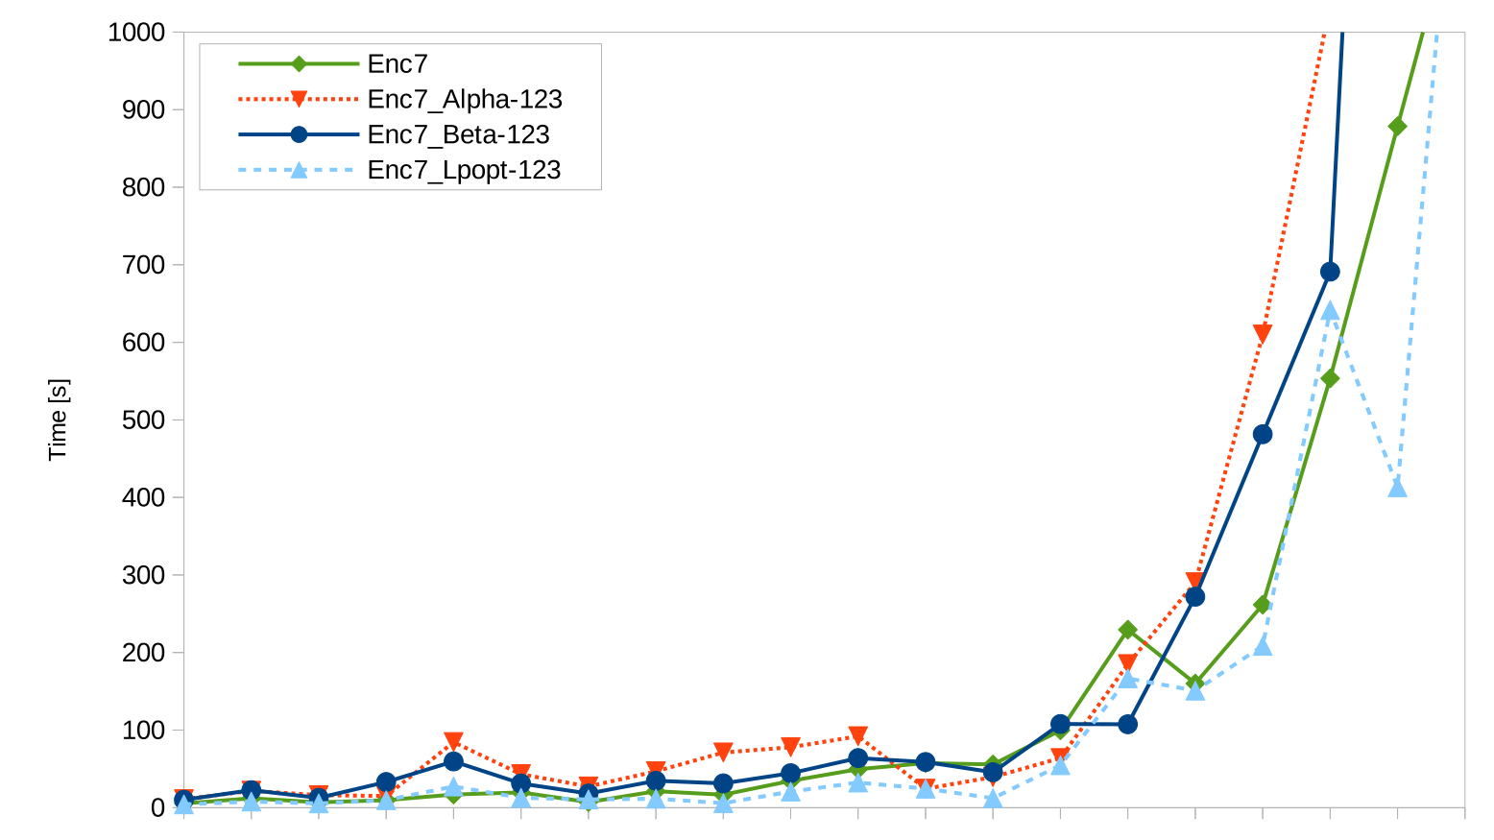
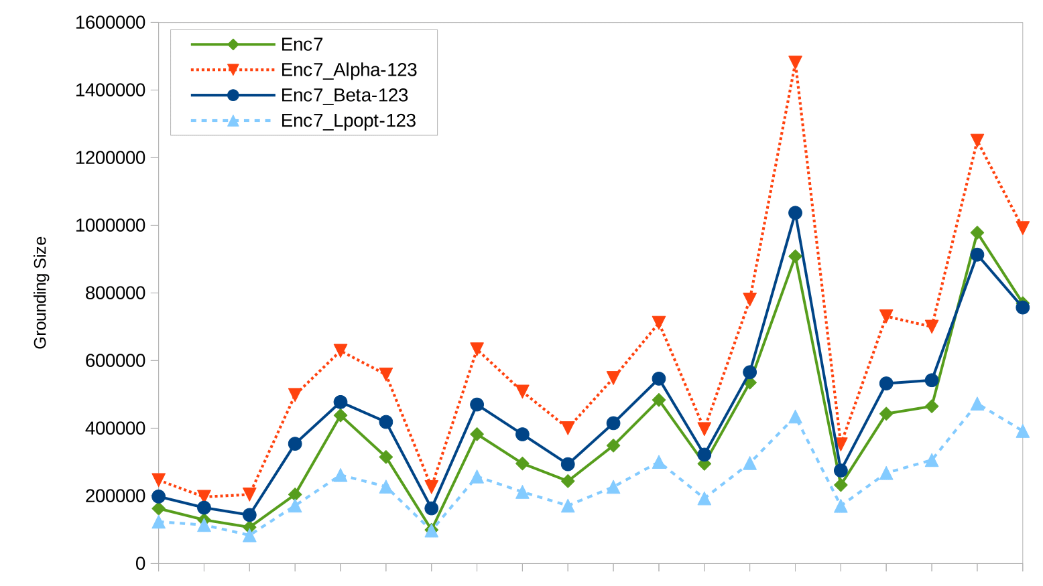
ASPCCG: Encoding 7
Solve Time
Grounding Size

Slide 29
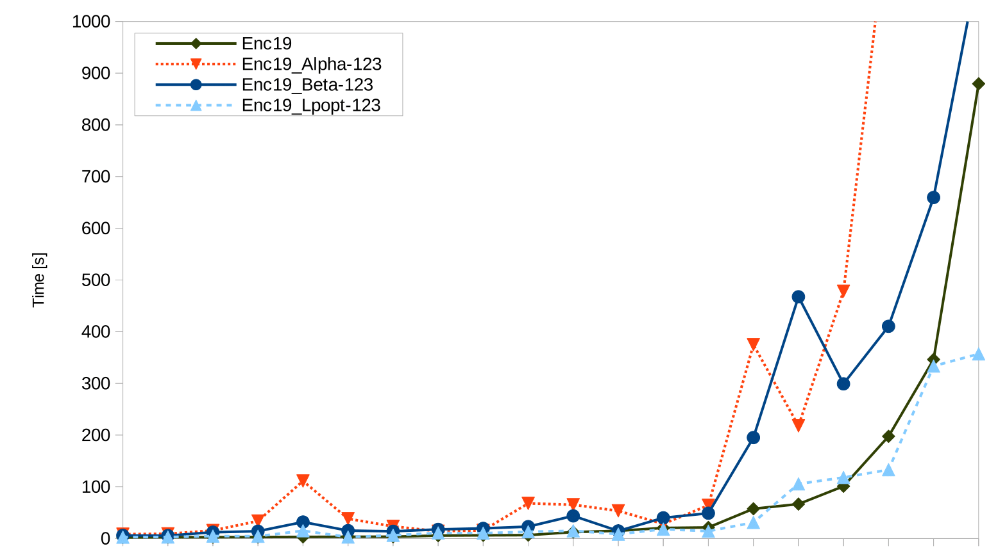
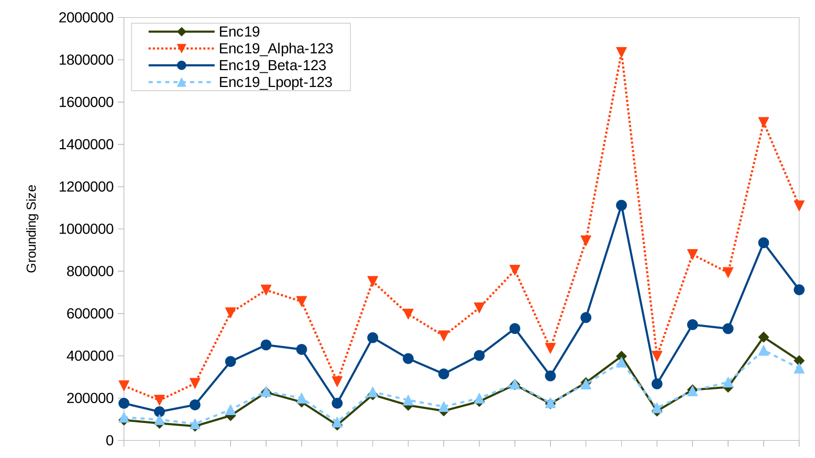
ASPCCG: Encoding 19
Solve Time
Grounding Size

Slide 30
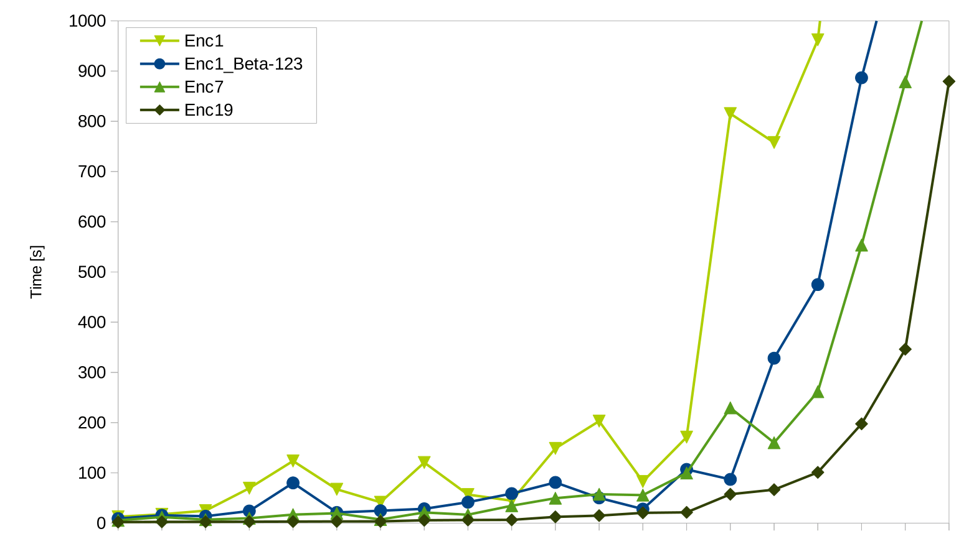
ASPCCG: Overall

Slide 31
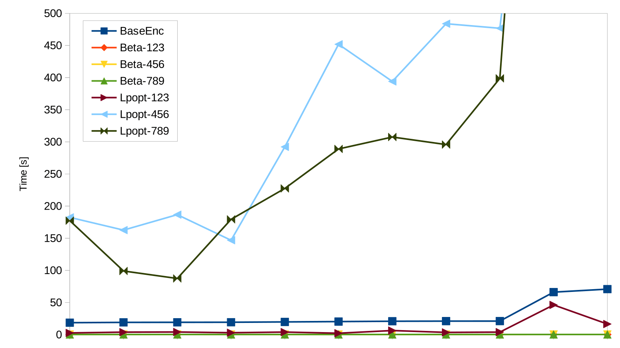
Stable Marriage
Solve Time
Notes:
Note why and what they are looking at with the 3 different lpopt and beta projections

Slide 32
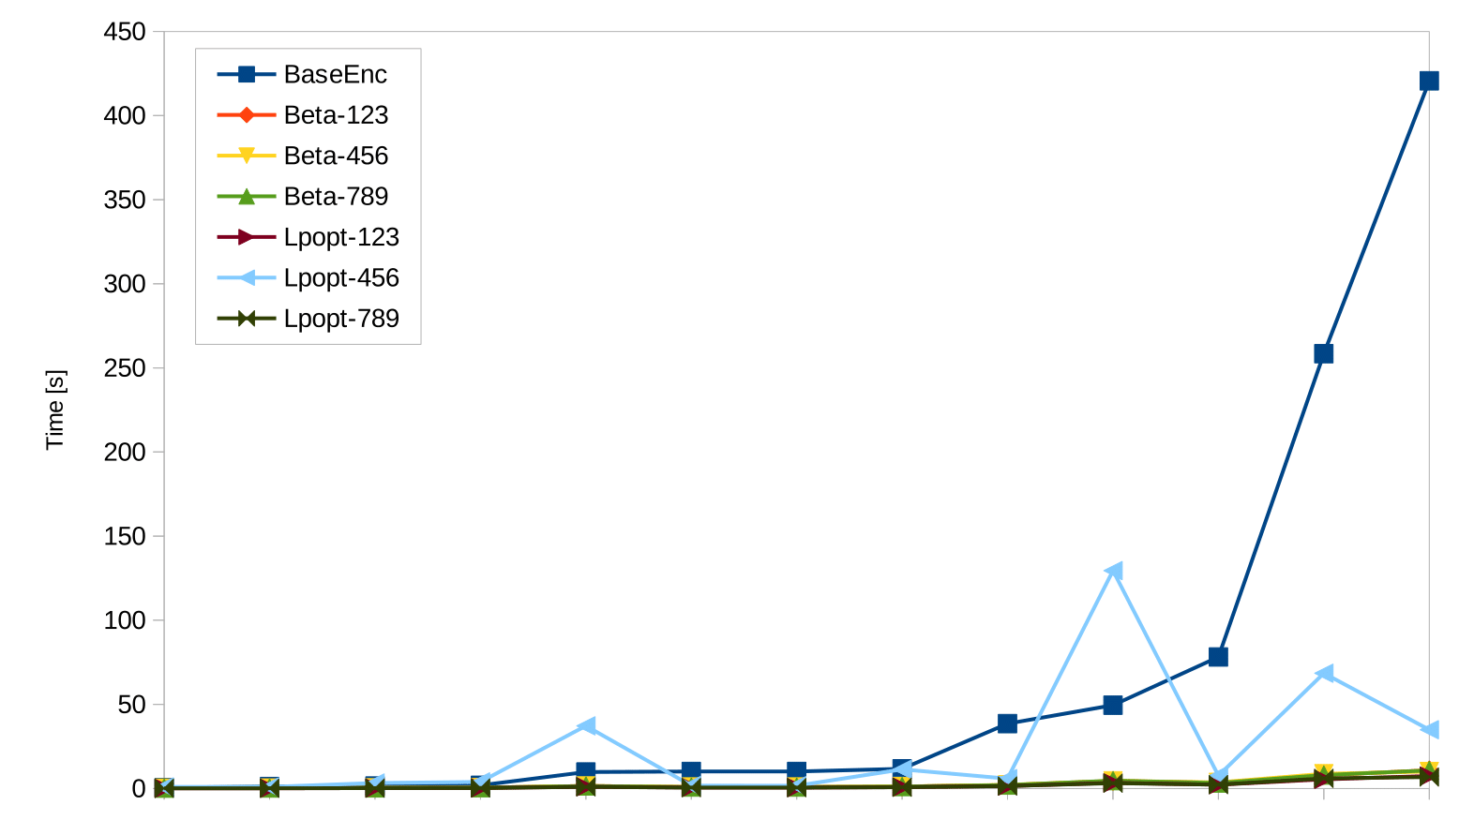
Permutation Pattern Matching
Solve Time

Slide 33
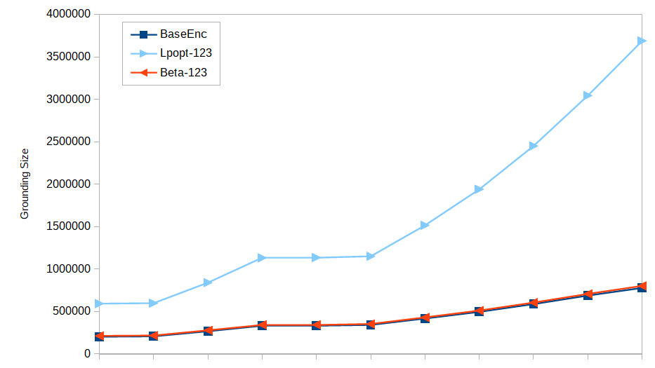
Knight Tour with Holes
Grounding Size

Slide 34
Conclusions, Current & Future Work
Conclusions
Automatic rewriting techniques are worth exploring
System PROJECTOR available on the UNO NLPKR Lab website
Current Work
Improve language support
More experiments
Future Work
Better heuristics for variable selection (grounding size prediction)

Slide 35
Acknowledgements
Michael Dingess
Brian Hodges
Daniel Houston
Roland Kaminski
Liu Liu
Dr. Mirek Truszczynski
Stefan Woltran

Slide 36
Thank You! Questions?

