Slide 1
CodeCrush 2015: IT Innovation
Dr. Christopher B.R. Diller
School of Interdisciplinary Informatics
College of Information Science & Technology
cdiller@unomaha.edu
Notes:
This presentation is designed for 8th-9th grade teacher/mentors participating in the “Code Crush” event on campus!
Be engaging! Be entertaining! Motivate them to think differently!

Slide 2
Diller: “Renaissance Man-in-training”
Education
Ph.D. (MIS & Social Psych) Univ. of Arizona
MS-DIS (SCM & IT) Univ. of Florida
MBA (E-Com & Marketing) Univ. of Florida
BS (Advertising) Univ. of Florida
Expertise & Training
Collaboration, Strategic Planning, & Facilitation
Advertising, Marketing, PR/IR, & IT Mgmt.
Performance (Music, Theater & TV/Film)
Industry Experience
Telecommunications (Wireline & Wireless)
Journalism, Government, Military, & Education
THE POLYMATH IDEAL:
Science
Philosophy
Theology
Humanity
UNIVERSAL SKILL SET:
Athletics & Medicine
Art, Writing, & Music
Cooking & Socializing
Planning & Execution
SPREZZATURA!
Notes:
During the Renaissance, Baldassare Castiglione, in his guide The Book of the Courtier, described how an ideal courtier should have polymathic traits – and CONSTANTLY display an attitude he called sprezzatura (meaning: sincerity, humility, grace, compassion, etc.).

Slide 3
Today’s Objectives
Innovation Defined
Collaborative Classroom/Research Initiatives
Importance of Historical Perspectives
Critical Thinking, Evaluation & Planning Skills
Developing “tech-friendly” skills WITHOUT technology!
Conclusions: “Moonshot Thinking”

Slide 4
Innovation Defined
[BACK TO TOPIC LIST]

Slide 5
What is an…
IMPROVEMENT?
Make something better
INVENTION?
Make something new
INNOVATION?
See things differently… create a unique solution… and apply it in a way that changes everything for the future!
Notes:
Ask each question… select students to give their answers, then display the answer once they respond correctly.
They’ll likely not be able to define innovation precisely… but give it a couple of shots… and encourage them after each response.

Slide 6
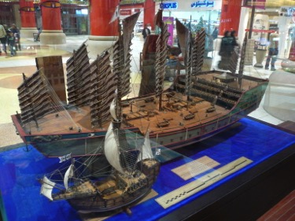
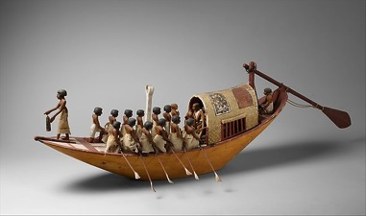
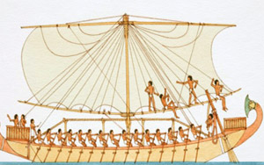
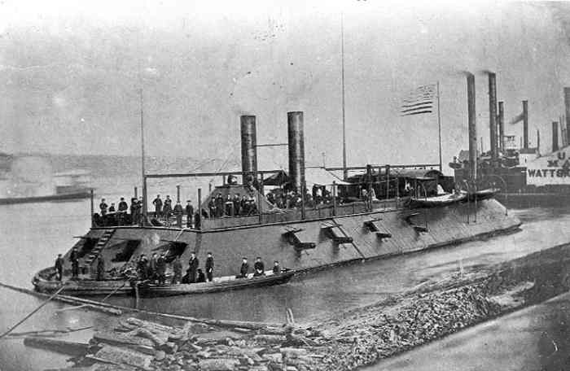
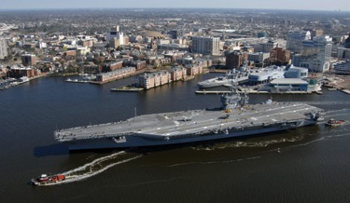
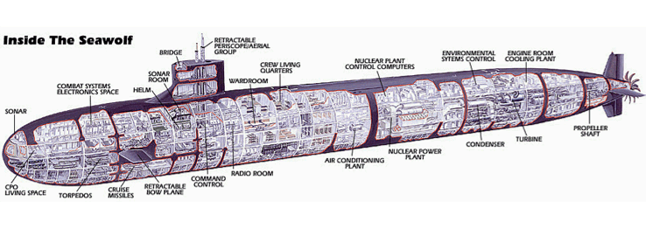
Examples – Improvements
Notes:
Discuss a few examples of how the concept of a boat has improved over the last 5000 years.
(Here’s what to say for each picture…. Going LEFT-to-RIGHT… starting at the top row)
Here’s an ancient Egyptian boat (circa 2000 BC)… what did they use to make the boat go? [OARS]
Here’s an IMPROVED ancient Egyptian boat (circa 1900 BC)… the INVENTION of the sail made rowing not as important when downwind!
There are two boats in the picture: [LOWER] A Spanish galleon, like the one Christopher Columbus used in 1492… and [UPPER] a HUGE Chinese war ship from 1100! (WOW!)
By the American Civil War (mid-1800s), boats could be made of iron and steel!... And steam engines made sails no longer necessary!
Today’s modern aircraft carriers are MASSIVE! This is a Nimitz-class carrier sailing through a small town’s harbor! Nuclear reactor used for propulsion!
We don’t have to constrain ourselves to being ABOVE the water! This HUGE Seawolf-class submarine can withstand depths of nearly 2000 feet below the surface!
This slide shows how certain improvements to a basic tool are achieved using inventions!

Slide 7
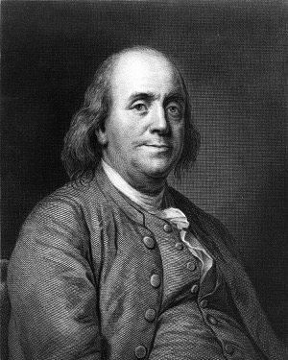
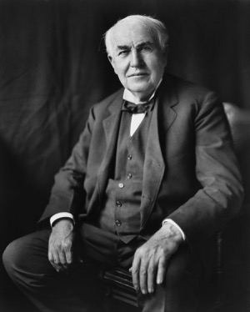
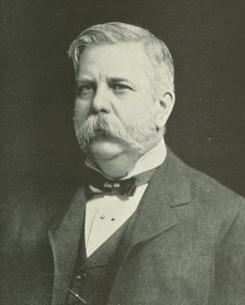
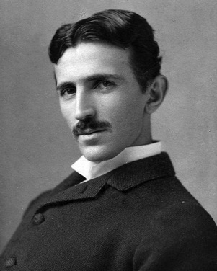
Examples – Inventors
Benjamin Franklin
Thomas
Edison
George
Westinghouse
Nikola
Tesla
Notes:
Ask the students: WHAT DO THESE FOUR MEN HAVE IN COMMON?
(Answer: They are all inventors that worked with electricity!)
BEN FRANKLIN: Didn’t really “invent” electricity… but proved that it was NOT a fluid! (At the time, most people thought it was a fluid!) Also proved it had positive/negative charges!
TOM EDISON: Invented the light bulb… AND… a way to bring electricity into people’s homes! (Using DC – “direct current”)
GEORGE WESTINGHOUSE: He was Edison’s primary competitor… also had a way to bring electricity to the home! (Using AC – “alternating current”)
NIKOLA TESLA: Westinghouse’s most brilliant young engineer! He even devised a way to transfer electricity via the airwaves (you didn’t need cables!).
Edison won the “battle of the currents” and his standard is used for most electricity today… he won because he had a BETTER TEAM (and more money). He also resorted to some shady “scare tactics” (including building an electric chair with Westinghouse’s AC) to win the battle.
HOWEVER… most experts today believe that Westinghouse/Tesla’s AC was the superior alternative! It was much safer than Edison’s DC, and cost a LOT less to distribute long-distance!
THE LESSON HERE – These guys all had great INVENTIONS… but Westinghouse/Tesla didn’t INNOVATE because they didn’t have the right team (or resources) to help them win!
(Later, you should come back to this point – UNO’s School of Interdisciplinary Informatics allows students to collaborate with LOTS of experts! We have a better team!)

Slide 8
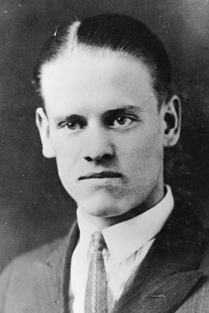
Example – Invention
Philo Farnsworth
Notes:
Here, you’ll relate the story of Philo Farnsworth… the inventor of the television!
He lived in Rigby, Idaho, and traveled (by horse-drawn carriage) to Salt Lake City at age 10… and that’s where he experienced his first TELEPHONE call! He was amazed!
But his little girlfriend had recently moved away (to California)… and he missed her. He wondered: “How can I make a call so that I can hear AND SEE her?”
In 1917 (at age 11), he handed his middle school science teacher a schematic of how a television system might work. The teacher didn’t understand it… and took it to the faculty at BYU. They immediately validated his work – it was possible. But the BYU faculty dismissed the importance of the invention… “it’s not worth our time.”
By 1929 (at age 23) Farnsworth had completed his best working prototype.
FIRST IMAGE EVER DISPLAYED ON TV? A DOLLAR SIGN!! ($) His funding sponsors were always hounding him… saying “we expect to see money out of this someday!” (LOL)
SECOND IMAGE EVER DISPLAYED? Farnsworth’s wife… although he needed so many bright lights to make it work, she couldn’t even open her eyes!
For the next decade, the best use of the technology was determined to be: (NOT entertainment!)… “America’s Most Wanted!” (Chicago PD could televise pictures of criminals to other police departments around the country!) Nobody really believed that this would be in the home until into the mid-1940s!
Also, nobody really considered BROADCASTING the images via radio waves yet! Farnsworth’s television was still a WIRED mode of communication!
This is why he was NOT an innovator! He had a GREAT invention… but it took someone else’s vision to change the world (and bring broadcast TV to American homes).

Slide 9
Examples – IT Innovators
Notes:
Discuss the innovative contributions of each of these firms:
APPLE = iPod = Totally eliminated the need for physical recorded music media (CDs, cassettes, albums, etc.) – CHANGED THE WORLD FOREVER!
INTEL = Lexicus = Getting close to REAL-TIME language translation! Imagine being able to call ANYONE on Earth and have a conversation with them… even if they don’t speak English, and you don’t speak their language!
GOOGLE = Search = They eliminated the need for dictionaries, encyclopedias, and to some extent LIBRARIES! Truly an innovative product!
GoPro = small, durable HD video cameras = Guy just wanted to share his “extreme” sports activity with his friends! Sony, Panasonic, JVC, Toshiba… they all PASSED on the opportunity!
PayPal = online financial micro-transactions = They eliminated the need for bank-centered money transfer!
SpaceX = commercial space flight = Government missions were too expensive and inefficient! We can do it cheaper and better!

Slide 10
The Collaborative Classroom
[BACK TO TOPIC LIST]

Slide 11
School of Interdisciplinary Informatics
Computer Science & IT
Management Information Systems
Business Administration
Biomedical Technology
Psychology & Sociology
Engineering & Architecture
Notes:
Here, you will remind the students that to be truly INNOVATIVE… it’s not enough to have a great idea (or even a great prototype)… you need a TEAM of EXPERTS that can help you transform your INVENTION… into an INNOVATION that changes the world from this point forward!
At UNO, the PKI Institute features world-class experts in ALL of these domains… we are a good TEAM for entrepreneurs to partner with!
And… we will teach you how to view the world differently… and solve problems more creatively!

Slide 12
Applied Innovation Lab
It is our mission to:
Work collaboratively…
To solve real-world problems…
Through hands-on experience…
With interdisciplinary research teams…
Resulting in innovations that will re-shape our world.
Notes:
This should be self-explanatory.

Slide 13
Collaborative Classroom Functions
Feedback-generation tools
Allow students to suggest interesting or problematic topics
Rank-order voting tools
Measure student interest in real-time
PowerPoint integration & commenting
Allow anonymous backchannel comments with minimal intrusion
Quick-survey (and/or "Pop-quiz") tools
Measure/verify understanding of material
Multimedia integration
e.g., streaming video for distance education or remote participants

Slide 14
Methods to Personalize a Class
Students democratically select grading instruments
Students democratically select exam dates/deadlines
Daily “attendance questions” (demographic data)
L01/L02: “Ideal Employer” and “Brand Champion” firm
Personalized nameplates (with above logos)
$1200 Ideas: Value-added “life advice”
$1200 = Value of a UNO class period with 50 students

Slide 15
$1200 Idea: Interview Differentiation
Reeves’ “Unique Selling Proposition (USP)”
Opening interview question: “Tell me about yourself”
HAVE A WELL-PREPARED ANSWER!
Compelling, focusing on demonstrated benefits!
NO LONGER than 60 seconds!
Diller’s USP: “I create SOMETHING out of NOTHING!”
Quickly turn mismanaged assets into strategic advantages

Slide 16
Collaborative Innovation Exercise
“Diagram a process’ steps for a minion”
Collect diagrams and re-distribute to class
Have students IMPROVE another’s diagram
Collect diagrams, re-distribute to ORIGINAL “owner”
Have students INCORPORATE the improvements
Form working groups to discuss PROCESS innovations

Slide 17
The PRACTICAL Collaborative Process

Slide 18
Importance Of History
[BACK TO TOPIC LIST]

Slide 19
My High School Challenge
“You’re highly intelligent, socially gifted, capable of achieving ANY goal… but every day, before you rest on your laurels, simply ask yourself:
‘How much of the world could you re-build?’
You must keep learning. You must continually evolve. Only then, will you ever truly be an asset to society.”
— James M. Warford (May 30, 1987 @ 1:00 PM)

Slide 20
My Undergraduate Experience
My educational objective: Become a polymath
HIGHLY-involved on campus (athletics, fraternity, events)
DIVERSE curriculum choices (CS, meteorology, business)
My initial focus: Improve writing skill! (Journalism)
Unintended consequence: Mathematics skills declined
2nd-year epiphany (after earning a “D” and a “C”):
Writing was okay, my knowledge of history was AWFUL!

Slide 21
My Undergraduate Epiphany
“Your experience isn’t unusual. Most students aren’t able to LEARN from history, because our primary education system focuses on rote memory and recall for class success. To be a great student of history, you must UNDERSTAND and ANALYZE past events IN CONTEXT to be able to APPLY them to the present.”
— Augustus M. Burns (May 4, 1989 @ 4:00 PM)

Slide 22
My Undergraduate Challenge
“I recommend that you start CONTEXTUALIZING history – associating it with something you really like. Take your favorite hobby and begin to learn the dates of important events in that arena… then, start re-learning your US and world history as they relate to your hobby!”
— Augustus M. Burns (May 4, 1989 @ 4:02 PM)

Slide 23
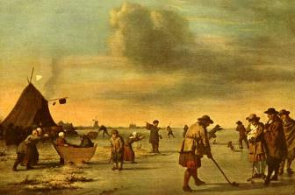
The Year 1457 in Review
Military prohibited from playing golf in Scotland
Incas finish building Macchu Picchu (Peru)

Slide 24
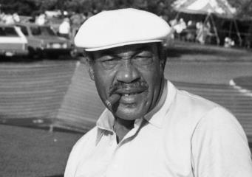
The Year 1957 in Review
Charlie Sifford wins on the PGA Tour (11/10)
Eisenhower’s 2nd term
Russia’s Sputnik 2: Dog orbits Earth
IBM FORTRAN launched
Boeing 707 test flights
Elvis / Frisbee / Beaver

Slide 25
How This Method Really Works
MEMORY TYPE |  | FUNCTION | REGION
IMPLICIT |  | Physical skill sets | Striatum / BG
EXPLICIT | Semantic | Factual recall | Hippocampus Entorhinal cortex Perirhinal cortex Temporal cortex
 | Episodic | Situational recall
 | Autobiographical | Personal experience recall
WORKING |  | “Buffer” storage for DM | Pre-frontal cortex
EMOTIONAL |  | Strong physiological response | Amygdala

Slide 26
Remembering History’s Lessons
“Those who cannot remember the past are condemned to repeat it!” – George Santayana
Even the most powerful empires can fail… as soon as they can no longer effectively defend (or adequately support) their territory.
Notes:
At this point, I am going to choose my words carefully… you don’t get to be a general without a SUPERIOR knowledge of history! Your understanding FAR exceeds my own!
However, I will be using these historical examples to reinforce the following notions:
-- You know more about winning a marketing/branding battle than you might think!
-- Just because you may be untrained in the marketing discipline (from a formal perspective) doesn’t mean you don’t already know how to win!
-- I want to use these illustrations to “jump-start” your thinking… and get you to apply your knowledge and skill set to the problems in a different way!
You can handle this… you know what to do… trust your instincts! Re-think the situation in these terms, and I think your direction will be clear.

Slide 27
Lessons from History – Part 1
EMPIRE | TIME PERIOD
Egyptian | (1550 BC - 1077 BC)
Macedonian (Greek) | (808 BC - 168 BC)
Roman | (753 BC - 476 AD)
Asian (Various) | (1st, 8th, 13th, 14th, 18th, 19th, and 20th Centuries)
Russian | (19th & 20th Centuries)
British | (18th, 19th, & 20th Centuries)
Notes:
"It's incredibly difficult to fight battles in multiple theaters. Even the most powerful empires can fail… as soon as they can no longer effectively defend (or adequately support) their territory.“
-- Egyptian downfall was rooted in poor financial/resource management
-- Greeks suffered from disadvantageous positioning (vis-à-vis the Romans)
-- Romans also managed finances poorly… didn’t excel at logistics/supply chains (to the extent they needed)… and their strategic vision was not embraced by all, it was NOT a “unifying force.”
-- Russian empire centered around obtaining critical resources, but lack of innovation, limited manufacturing capacity, and lack of wealth creation led to downfall
-- At one point, “The sun never set on the British Crown.” … but it lacked the resources to maintain/defend those territories around the globe!

Slide 28
Lessons from History – Part 2
WAR | CONTRIBUTING SUCCESS FACTOR
US Revolution | Guerilla Tactics, Strategic Alliances
US Civil War | Core Capabilities (Industrial Mfg.), Supply Chains
World War I | Technology, Tactics
World War II | Leadership, Logistics, Supply Chains, Alliances
Korea/Vietnam | Wars of Attrition, Niche Positioning, Commitment
Notes:
Korean War is either still going on… or it was a draw… depending upon your point-of-view. Factors listed above are what contributed to the stalemate.
The point of this slide is NOT to be authoritative or 100% accurate… ALL of the assertions on this slide are HIGHLY debatable!
The point is: The ways you win a war… are often the very same ways you win a business “battle” (or a competition for industry “prizes”).

Slide 29
Technology Timeline
 | Invention Year | Commercial Service | Commercial Success
Telephone
Fax Machine
Television
1876
1885
1964
1861
1972
1987
1911
1939
1954
Pager | 1940s | 1964 | 1985
Cellular Phone | 1946 | 1978 | 1994
E-mail | 1960 | 1981 | 1994
Notes:
The lesson here: Even truly innovative technologies take a LONG time to develop sufficient adoption… and their use may evolve/change over time! Even today’s most innovative technological achievements are subject to long delays!
Students are better served by teaching them how to identify NEW uses for OLDER/EXISTING technologies!

Slide 30
“Non-tech” Tech Class Discussions
Critically discuss new products/services/applications
Identify WHY they are successful
What were the best options BEFORE?
Identify/discuss replacements or alternatives
Could these be improved even MORE?
Discuss historical technological FAILURES, too!
Why weren’t they valued? Where did they go wrong?

Slide 31
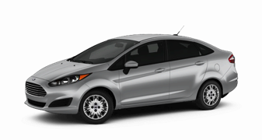
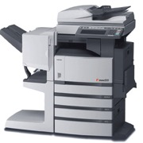
The MOST Beneficial Tech Skill
Find a NEW use for an OLD technology!
“Trailing-edge Innovation”
Example: BellSouth Cellemetry
1996: Digital cellular networks launched in US
1996: Analog cellular network use PLUMMETED!
1997: ex-BellSouth employees bought analog networks
2015: $2B/year revenues for “remote telemetry” services

Slide 32
Critical Thinking & Planning
[BACK TO TOPIC LIST]

Slide 33
Valuable Skills for Innovative Thinking
See things differently
Identify people’s problems
Diagram processes (Flowchart/PERT)
Develop realistic schedules (GANTT)

Slide 34
Skill #1: See Things Differently – 1
Notes:
So, being an innovator means “seeing the world differently” … let’s test this, and see if you see things that other people might miss.
What is so special about the FedEx logo?
(Once you see it, you’ll NEVER look at this logo the same way again!)

Slide 35
Skill #1: See Things Differently – 1
Notes:
Once you start to notice the details in the minor things around you… you’ll be better able to solve complex problems… and truly INNOVATE!

Slide 36
Skill #1: See Things Differently – 2
Notes:
Let’s try another example…
Did you know that the Wendy’s logo has the word “MOM” in it?
See for yourself… it’s right there on her collar!

Slide 37
Skill #1: See Things Differently – 3
Notes:
The LG logo… if you spin it a little… and slide the L over to the edge… it makes a PAC-MAN! (LOL)

Slide 38
Skill #1: See Things Differently – 4
Notes:
KEY POINT HERE – PERSPECTIVE IS IMPORTANT! (Learn to look at life from different perspectives! Upside-down, inside-out, reverse order, whatever!)
These kids will be FAR too young to know what a Dodge Viper is… so remind them that this super-charged sportscar cost between $75,000-100,000!
In early 1998, a mechanic had removed the hood of a Viper… and leaned it against the wall… when his work was done, he noticed that (when upside-down) the Viper icon looked just like Daffy Duck! (LOLOL)
Dr. Diller believes that this was the first Internet-based “viral” message… it went global within a matter of days… and Dodge executives didn’t think it was very funny.

Slide 39
Skill #2: Identify People’s Problems
Talk to others… LISTEN to what they say!
Find out: “WHY?”
Identify possible solutions to ease their pain
Ask yourself: “WHY NOT? WHAT HOLDS US BACK?”
Then, ask: “Is there an EXISTING technology that I can use in a different way to make this solution a reality?”
Notes:
Encourage the kids to LISTEN to other people… find out what problems they face… and motivate them to think of ways to solve those problems!
WHY? Why is that problem so painful? Why haven’t other people been able to fix it yet?
When they come up with potential solutions… they should ask themselves: WHY NOT? WHY SHOULDN’T THINGS BE DIFFERENT? THEY SHOULD BE MY WAY!
If you succeed, and get people to adopt your solution… that is the moment that you become an innovator.

Slide 40
Skill #3: Diagramming a Process
Flowchart Example
PERT Chart Example

Slide 41
Skill #4: Project Scheduling (Gantt)

Slide 42
What you are REALLY teaching…
“Pseudo-coding”
Technology developers are NOT all coders!
Logical thinking is the KEY characteristic of great coders
Good development starts with a plan
Good flowcharts or PERT charts are EASILY translated!
Good development is managed by a “production” schedule
GANTT chart development has MULTIPLE benefits!

Slide 43
Conclusions
[BACK TO TOPIC LIST]

Slide 44
Google X’s “Moonshot Thinking”
Notes:
Google X’s “Moonshot Thinking” Video: http://www.youtube.com/watch?v=0uaquGZKx_0
If you haven’t seen this… it’s worth 3 minutes and 45 seconds of your time. Thank Diller later.

Slide 45
Key Take-Aways
You CAN develop “tech skills” WITHOUT tech!
It’s much easier if you:
Clearly define the objectives (or desired skills)
Work collaboratively WITH students to personalize!
Enhance students’ knowledge of history (evaluation skills)
Encourage critical thinking and use of planning tools

Slide 46
http://appliedinnovationslab.com
Dr. Christopher B.R. Diller
School of Interdisciplinary Informatics
College of Information Science & Technology
cdiller@unomaha.edu

