Slide 1
Department of Counseling University of Nebraska at Omaha New Student Orientation
Summer/Fall 2024
Notes:
Tina

Slide 2
Our Epic Team ☺
Dr. Tina Chasek
Department Chair
Student Affairs Coordinator
Clinical Mental Health Faculty
Dr. Abby Bjornsen-Ramig
Clinical Mental Health Faculty
Clinical Training Director
Dr. Ashley Blount
Clinical Mental Health Faculty
Dr. Isak Kim
Clinical Mental Health Faculty
Dr. Alex Fields
Clinical Mental Health Faculty
Dr. Thang Tran
Program Coordinator and School Counseling Faculty
Instructor Rebecca Moore
Clinic Supervisor, CMHC, School Counseling
Instructor Kara Schneider
CMHC
Ms. Barb Newell
Administrative Assistant
Pedro Tostes Ribeiro Radusewski
Graduate Assistant
Hannah McIntyre
Graduate Assistant
Audre Bedford Hansen
Community Counseling Clinic Coordinator
Adjunct Faculty
Additions to Faculty/Staff
Notes:
All introduce
New Ga and Praveen

Slide 3
Your ESU 2 and UNO Team
ESU 2 pays for the courses, books, fees, ignore any statements from UNO that ask you to pay!
ESU 2 is the administrator of the program and the finances, they handle logistics of the grant program; they make the final decisions on all eligibility and requirements
UNO delivers the course content
You are a student of UNO and follow UNO academic policies
UNO will coordinate with the bookstore to have your books delivered, respond to any emails you get about that
ALWAYS Check your UNO email for information from us
Dr. Diane Wolfe, ESU 2
Brandi Arneal, ESU 2
Dr. Thang Tran, UNO Advisor
Dr. Tina Chasek, UNO Chair
** Please get any outstanding information to the Graduate office or GA’s ASAP!! (transcripts, letters of recommendation, etc.)

Slide 4
A Tradition of Excellence
Fall 2024 marked Counseling Dept’s 61st year at UNO.
Clinical Mental Health & School Counseling specializations have been CACREP-accredited for nearly 3 decades.
Excellence on national exams- high pass rate.
The majority of our graduates from all concentrations are working in the fields of counseling and/or education w/in 6 months.
Excellent clinical training experiences in the Community Counseling Clinic, Schools, Institutions of Higher Education, and Community Counseling Sites
Notes:
Ashley

Slide 5
How to get the information you need
Faculty Advisor
Can find in Mavlink
If not there please let us know!
Counseling Dept. Listserv- must USE your UNO Email!
Graduate Assistants
Admin Assistant
Email best way to communicate
Dept. website
Forms and Documents
Student Handbook
Course Rotation
Plans of Study
Notes:
Ashley/Abby

Slide 6
Student Handbook
Available on the Department Website
Must read review as a condition of acceptance into the program.
In addition to the Graduate Student catalog, the Counseling Department Handbook contains the policies and procedures of the program and can be used for reference throughout the program
Acceptance of admission into the program indicates your agreement to abide by and follow the policies in the handbook

Slide 7
Ethical and Professional Obligations
Informed Consent For Admission
Document from Admissions interview
ACA Code of Ethics
Student Handbook:
Administrative Policies and Procedures Regarding Student Conduct
Student Professional Dispositions
Review of Progress
Professional and Personal Growth Expectations

Slide 8
As you get going…
Background Check (admission/practicum)
Background Check Procedure in admissions packet- must be completed by enrollment of your second semester- there will be a hold on your account until it is completed!
2 Part process: initial and then email from DHHS
Instructions are on the webpage
Liability Insurance (Practicum/Internship)
ACA, ASCA, Open Market
Transfer credit
Work with advisor to request any graduate transfer credit
Policy is in the handbook
Course Delivery Methods
Make sure you read the notes in the system for
the correct section to register for
Notes:
Tina ABR

Slide 9
…A few more
10-year timeline for degree completion
Graduation/Exit Requirements
CMHC: Counselor Professional Competency Exam (CECE)
School Counseling: Written Comprehensive Exam, Praxis Subject Test (SC), RAMP
National Counselor Exam
NOT a graduation requirement/exit exam requirement, but optional during Intern II semester.
Rebecca Moore is NBCC Liaison and point of contact for CECE & NCE exams
Student Affairs Comprehensive Exam
Licensure/Certification – Eligibility
CMHC and School Counseling
Notes:
Tina/Thang

Slide 10
Expectations of Counseling Graduate Students
Preparation, Writing, and Exams
Evaluation (faculty and students)
Grade of B or above in all courses.- Any F is automatic dismissal per Graduate College
Attendance and Active Engagement
Prepare for time commitment practicum, and internship advance of the semester
Notes:
Isak

Slide 11
Practicum & Internship
Practicum Orientation Process differs between specializations.
Completion of all practicum pre-requisites and/or co-requisites required for enrollment in practicum
Orientation will be announced on the listserv!
Student Handbook & faculty advisors are key resources for information on practicum & internship.
Avoid the grapevine ☺
School & CMHC Practicum and Internship options at UNO & around the Omaha Metropolitan Area
Practicum experiences in the Department’s Community Clinic- CMHC
Student Affairs Higher Education
Notes:
Abby/Ashley/Thang

Slide 12
Program of Studies-Website
CMHC
SC
SAHE
Bridge

Slide 13
Bridge Program of Study
See Program of Study basics
See State of Nebraska Licensure requirements
Must have:
Degree in BH field
60 credit hours
Courses in the required areas
600/700 hour internship under supervision of an LMHP (300 Direct hours)
Work with advisor to finalize your plan
NO guarantee that you will be licensed it is up to the Licensure Board!

Slide 14
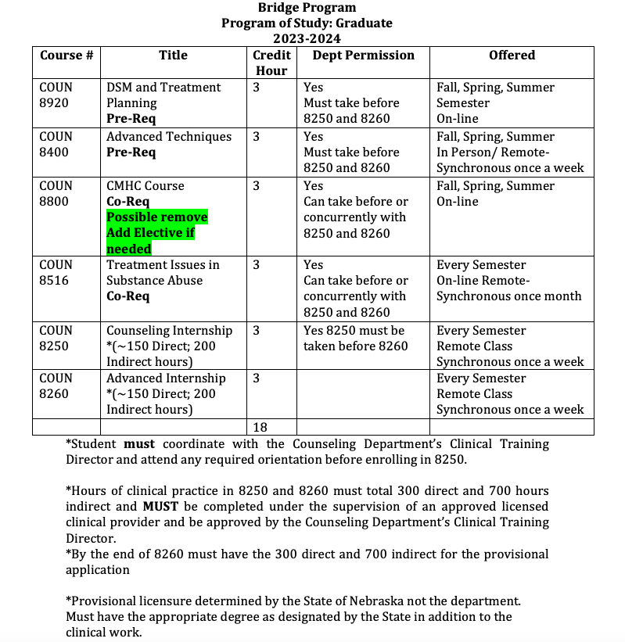

Slide 15
*Provisional licensure determined by the State of Nebraska not the department. Must have the appropriate degree which is 60 credit hours and contains required courses as designated by the State in addition to the clinical work.
Theories and Techniques of Human Behavior Interventions (6 credits)
Professional Ethics and Orientation (3 credits)
Assessment Techniques required for Mental Health Practice (3 credits)
Human Growth and Development (3 credits)
Research and Evaluation (3 credits)
Social and Cultural Diversity (3 credits)
AND
Practicum/Internship 300 direct hours 300/400 indirect hours while in an educational program
Full Licensure will require
An exam
3,000 of practice
The State application and information can be found on the State of Nebraska’s licensing page.
https://dhhs.ne.gov/licensure/pages/mental-health-and-social-work-practice.aspx

Slide 16
Chi Sigma Iota
Counseling academic and professional honor society
Purpose: To promote scholarship, research, professionalism and excellence in counseling
Opportunity: Professional Advocacy/Leadership
UNO’s Chapter: Upsilon Nu Omicron
Current Faculty Advisors: Dr. Kim
Can apply after 9 credit hours with the required GPA
Notes:
Isak

Slide 17
Get Involved in Professional Organizations
American Counseling Association (ACA)
American School Counselor Association (ASCA)
Nebraska Counseling Association (NCA)
Nebraska School Counselor Association (NSCA)
National Association of Student Affairs Professionals
Association of Counselor Education and Supervision (ACES)
Student Affairs Administrators in Higher Education
Association for Gerontology in Higher Education
Notes:
Isak

Slide 18
Two important professional opportunities
BHECN
Nebraska Counseling Association
Questions about these organizations can be directed to Dr. Chasek, Dr. Bjornsen-Ramig, or Instructor Moore
This Photo by Unknown Author is licensed under CC BY

Slide 19
Questions?
Notes:
Tina

Slide 20
Advisor Meetings
Now we’ll split into groups by advisor so you can become acquainted and discuss schedules for spring as well as other important information. Thank you for coming today, and welcome to the program ☺

