Slide 1
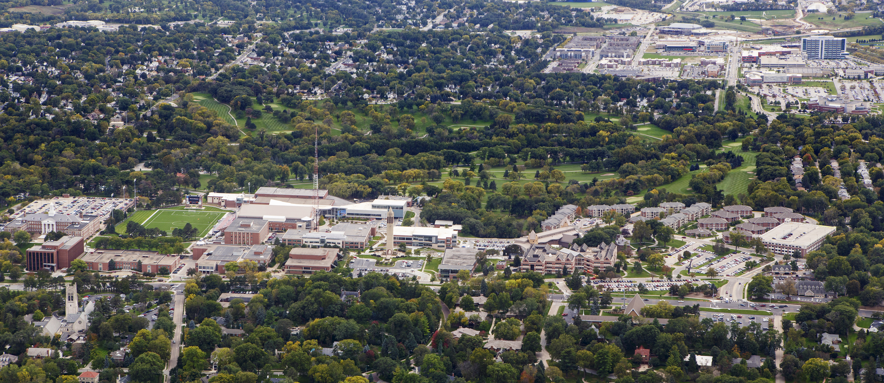
February 2015
Parking & Transit Update

Slide 2
Agenda
1. Guiding Principles & Parking Advisory Committee
2. Parking stall inventory & anticipated changes
3. Parking Utilization
4. Parking Adequacy
5. Parking Rates
6. Remote Parking Plan for 2015-16 Academic Year
7. Transit Options

Slide 3
Agenda
1. Guiding Principles & Parking Advisory Committee
2. Parking stall inventory & anticipated changes
3. Parking Utilization
4. Parking Adequacy
5. Parking Rates
6. Remote Parking Plan for 2015-16 Academic Year
7. Transit Options

Slide 4
Guiding Principles
Adequate parking stalls as evidenced by a low parking ratio
Community visitor access
Pedestrian & motorist safety
Reduce cars on campus:
    Carpooling
    Mass transit
    Bike & motorcycle
    Remote parking
Best practices in Parking Department operations
Plan and anticipate parking/transportation needs, including:
    Campus growth
    Class scheduling
    Impact of online courses
    Student housing
Oversight by Campus Parking Advisory Committee

Slide 5
UNO Parking Advisory Committee
Faculty:
Joshua Darr, Chemistry
Ana Carballal, Foreign Languages
Bobby Vasquez, English
Staff:
Karen Kempkes, Chair, Division of Continuing Studies
James Vogeltanz, Grounds
Lisa Paskewitz, Enrollment Management
Student:
Emily Bradley
Jared Malooley
TBA
Ex-officio:
Stan Schleifer, Director of Support Services
James Ecker, Manager of Parking Operations

Slide 6
Agenda
1. Guiding Principles & Parking Advisory Committee
2. Parking stall inventory & anticipated changes
3. Parking Utilization
4. Parking Adequacy
5. Parking Rates
6. Remote Parking Plan for 2015-16 Academic Year
7. Transit Options

Slide 7
Parking Stall Inventory
 | Spring 2015 | 2015-16 Academic Year | 2016-17 Academic Year | 2017-18 Academic Year
DODGE CAMPUS
On campus | 4,161 | 4,109 | 4,161 | 4,161
Off campus | 1,454 | 454 | 454 | 454
Subtotal – Dodge Campus | 5,615 | 4,563 | 4,615 | 4,615
PACIFIC CAMPUS
On campus | 2,478 | 2,158 | 3,453 | 3,453
Off campus | 103 | 103 | 157 | 157
Subtotal – Dodge Campus | 2,581 | 2,261 | 3,610 | 3,610
CENTER CAMPUS | 211 | 1,211 | 1,211 | 1,211
TOTAL | 8,406 | 8,034 | 9,435 | 9,435
Explanation of changes |  | - 52 (MBSC Renovation) - 1,000 at Crossroads + 1,000 at Center Campus - 320 at Pacific (Lots 7 & 8) | + 52 (MBSC Renovation) + 1,200 at Pacific (structure) + 95 (Lot 7) +54 street stalls

Slide 8
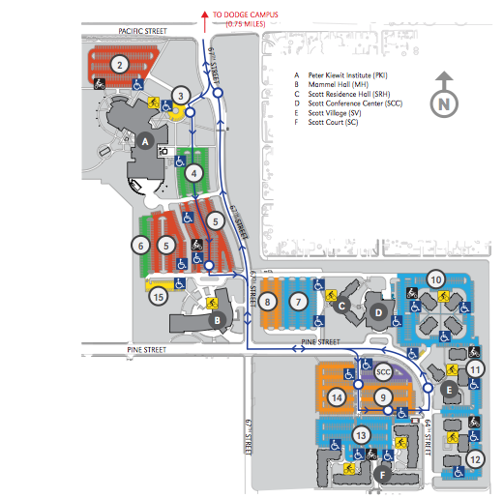
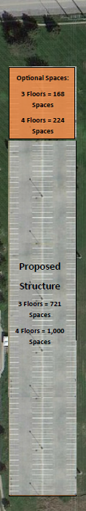
Pacific Campus Changes
Planned location
for parking structure
Planned location
for Housing/Academic &
Programmatic
mixed-use facility

Slide 9
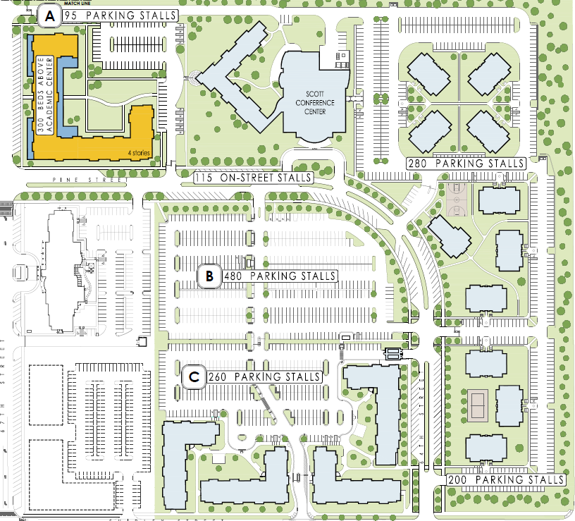
Pacific Campus Changes – Phase 1

Slide 10
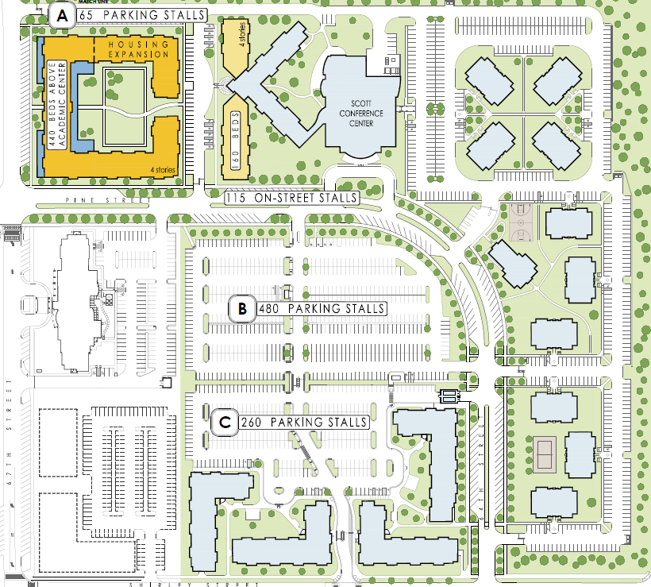
Pacific Campus Changes – Phase 2

Slide 11
Agenda
1. Guiding Principles & Parking Advisory Committee
2. Parking stall inventory & anticipated changes
3. Parking Utilization
4. Parking Adequacy
5. Parking Rates
6. Remote Parking Plan for 2015-16 Academic Year
7. Transit Options

Slide 12
Parking Utilization
Average Available Parking Spaces at ANY time
East Parking Garage | 335
West Parking Garage | 187
Lot 9 & 14 on Pacific Campus | 309
Total | 831
Note: Upper and lower levels are occasionally full during first two weeks of each Semester
Generally 200+ stalls are available at Crossroads, except during peak time

Slide 13
Agenda
1. Guiding Principles & Parking Advisory Committee
2. Parking stall inventory & anticipated changes
3. Parking Utilization
4. Parking Adequacy
5. Parking Rates
6. Remote Parking Plan for 2015-16 Academic Year
7. Transit Options

Slide 14
Parking Adequacy – All Stalls
 | Faculty & Staff | Students | TOTAL
People | 2,144 | 15,227 | 17,371
Parking Stalls (all stalls) |  |  | 8,406
Parking Adequacy Ratio (PAR) |  |  | 2.07
National average is 2.8 per the ENO Foundation for Transportation, Inc.

Slide 15
Parking Adequacy – UNO Stalls Only
 | Faculty & Staff | Students | TOTAL
People | 2,144 | 15,227 | 17,371
Parking Stalls (excluding public & street) |  |  | 7,849
Parking Adequacy Ratio (PAR) |  |  | 2.2
National average is 2.8 per the ENO Foundation for Transportation, Inc.

Slide 16
Parking Adequacy – Comparison to Others
Average
UNO
Averages
UNO
Source: ENO Foundation for Transportation, Inc.

Slide 17
Agenda
1. Guiding Principles & Parking Advisory Committee
2. Parking stall inventory & anticipated changes
3. Parking Utilization
4. Parking Adequacy
5. Parking Rates
6. Remote Parking Plan for 2015-16 Academic Year
7. Transit Options

Slide 18
Annual Parking Permit Rates (2014-15)
 |  | All-day | Night only (after 2:30pm)
Student | Surface Permit | $182 | $ 91
 | West Garage Permit | $233
 | East Garage Permit | $258 | $129
Faculty/ Staff | Surface Permit | $257 | $130
 | West Garage Permit | $289
 | East Garage Permit | $314 | $157
 | Reserved Parking Permit | $588-$700

Slide 19
Parking Permit Rate Comparison – BOR Peers
 | Student | Faculty/Staff | Reserved
UNO | $182 - $258 | $257 - $314 | $588-$700
University of North Carolina - Charlotte | $450 | $450 | n/a
University of Texas at San Antonio | $145 - $795 | $335 - $795 | $665 - $795
Portland State | $963 - $1059 | $1,284 - $1,920 | $2,508 - $2,664
University of Northern Iowa | $55 - $81 | $155 - $418 | n/a
Cleveland State | $205 - $287 | $799 - $992 | n/a
Wichita State | $120 | $20 - $156 | $650
University of Missouri – St. Louis | $576 | $744 | n/a
University of Colorado at Denver | $432 – $900 | $636 - $1,380 | $900
Northern Illinois University | $85 | $116 | $749
University of Arkansas - Little Rock | Included in fees | $0 | $165
Peer Average | $410 | $575 | $963
UNO’s highest rates, compared to the average of the other institutions, are: | 37% Lower | 45% Lower | 27% Lower

Slide 20
Parking Permit Rate Comparison - Other
 | Student | Faculty/Staff | Reserved
UNO | $182 - $258 | $257 - $314 | $588-$700
UNL | $528 - $636 | $528 - $636 | $1,044 - $1,164
UNMC | $156 | $276 - $360 | $840
UNK | $128 - $165 | $150-180 | $278
Creighton | $162 - $324 | $179 - $358 | n/a
University of Missouri – KC (CUMU Peer) | $315 - $420 | $496 - $732 | n/a
Group Averages | $335 | $480 | $740
UNO’s highest rates, compared to the average of the other institutions, are: | 23% lower | 35% lower | 5% lower

Slide 21
Short-Term Parking Options
 |  | Annual
Permits | 1 specific day/week | $ 64
 | 2 specific days/week | $128
Daily Parking in East Garage (Cash) | All Day in Lot T (lowest level) | $ 5.00/day
 | After 12 noon all levels | $ 2.00/day

Slide 22
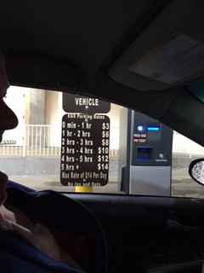
Short-Term Parking Options

Slide 23
Agenda
1. Guiding Principles & Parking Advisory Committee
2. Parking stall inventory & anticipated changes
3. Parking Utilization
4. Parking Adequacy
5. Parking Rates
6. Remote Parking Plan for 2015-16 Academic Year
7. Transit Options

Slide 24
Remote Campus Parking 2015-2016
Location:
  Parking lots on Center Campus, west of new UNO/Community Arena
  Access from new road (67th/68th Street) from Spring Street or from Mercy Road
Shuttles to Campus:
  Specific shuttles to/from Dodge Campus
  Specific shuttles to/from Pacific Campus
  Map on next slide
Hours:
  Shuttles will run 7am to 7pm
  Demand and construction on Pacific Campus may require expanded hours
Security:
  Contract security will focus on commuter lots — will also monitor other lots around Arena.
Permits:
  No permits will be required. This will be evaluated in future years.

Slide 25
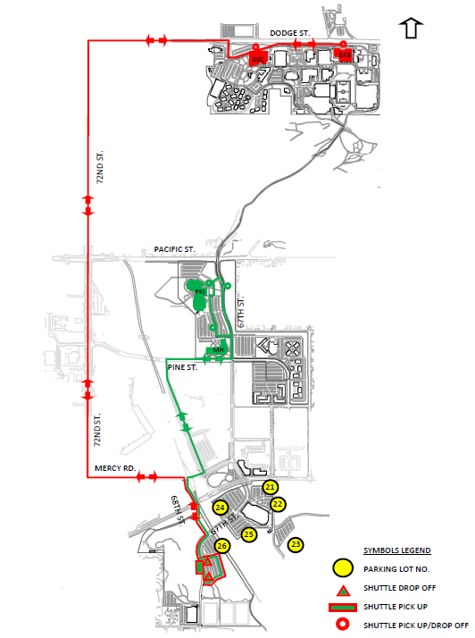
Shuttle Map From Remote Parking
Red = Remote lot
To/from Dodge Campus
Green = Remote lot
To/from Pacific Campus

Slide 26
Agenda
1. Guiding Principles & Parking Advisory Committee
2. Parking stall inventory & anticipated changes
3. Parking Utilization
4. Parking Adequacy
5. Parking Rates
6. Remote Parking Plan for 2015-16 Academic Year
7. Transit Options

Slide 27
Transit Options
MavRide
    Free Metro bus pass
    Student program in place several years (about 800 passes/semester)
    Faculty/Staff program started in January 2015
Zimride
    Social rideshare program designed for university communities
    Share rides will others who travel same route
    Routine or one-time
    Implementation February 2015
Emergency Ride Home
    Commuters can receive free ride home when unexpected emergencies occur
    UNO contracting with local taxi services
    Available to students, faculty and staff
Zipcar
    Car-sharing program (in place at UNO since 2013)
    Great option for those that need to use a car on an infrequent basis
    Starting in January 2015, Zipcar is available for UNO Department use

Slide 28



Office Hours: 8am to 5pm (M-F)
Eppley Administration Building, Room 107
402-554-PARK (7275)
unoparking@unomaha.edu
@UNOParking
University of Nebraska at Omaha Parking
Unomaha.edu/parking

